Slide 1
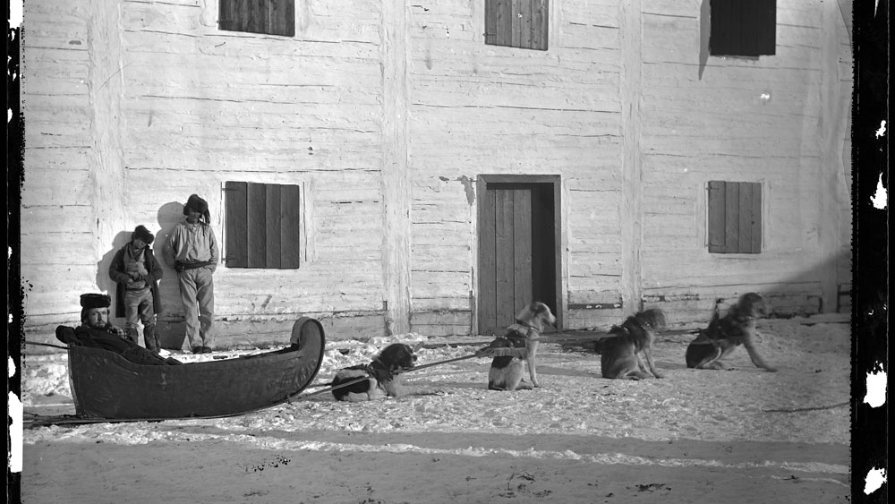



Notes:
Script: Introduction
My name is Hannah and I am a second year Creative Industries student.
My name is Julie and I am a third year Creative Industries student.
Our program Creative Industries had requested if we wanted to try a pilot class. The pilot class would help us develop and expand what we learned from our previous project. We are really thankful for all the help you have done in aiding us with information, and guiding us to our finished prototype.

Slide 2
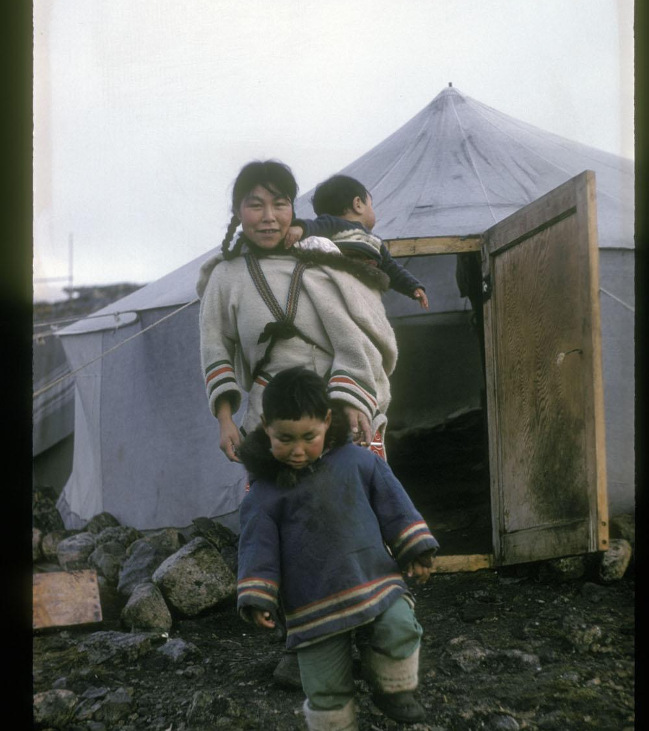
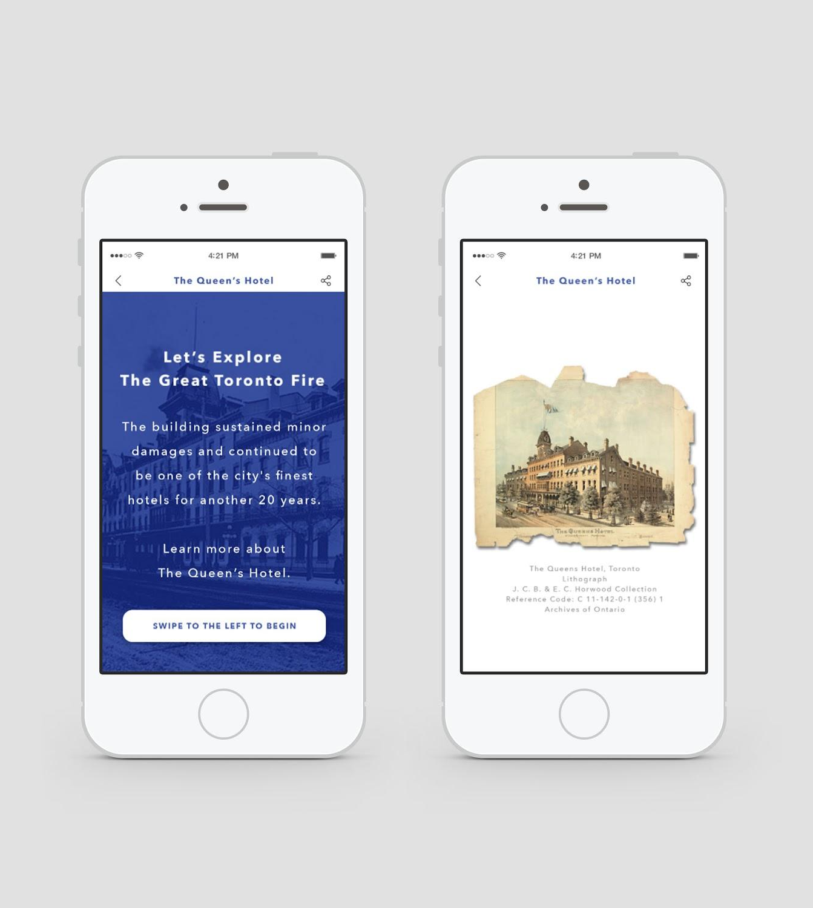
QR CODE TOUR
“I don’t have a QR code scanner on my phone, and I would less likely be keen on wanting to take up more phone storage. – Sarah Civil”
Team
Funding
Target Market
Notes:
Script: QR Code Tour
[Julie]
As you can tell, there is only two of us versus last time when there was five of us. Our team did not move forward, and therefore we were left with just the two of us to work on this project. Since we started the class in January, we knew our biggest issue would be funding. With the new restructuring of Ontario’s budget, this had major impacts on grants and expansion for the design.
Our original goal was to get more young people involved and interested in the Archives. We modelled this idea off of a similar initiative in New York called Urban Archive. It has gone off to be a major success, and has recently crowdsourced for their new updated programming. One of the major pain points we were able to deduce was young people did not want to download an app, and neither did most phones has a QR code imbedded into the program unless you have a Blackberry. Therefore, we realize our biggest challenge was the technology we were using.

Slide 3
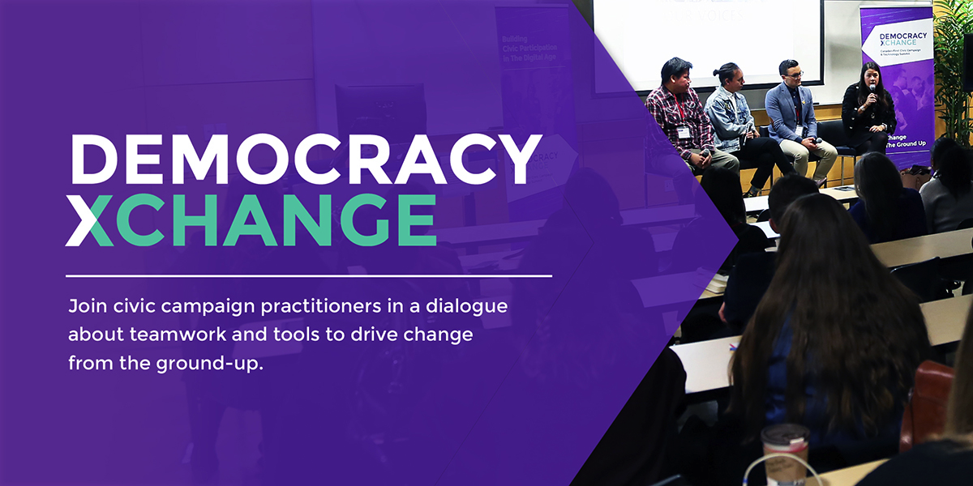
Notes:
Script: DemocracyxChange
[Julie]
This left us to go back to the drawing board. As we were researching how other countries and cities used open sourced data tools, and technology in collaboration with memory institutions–I was at a conference without Hannah called DemocracyxChange.

Slide 4

Notes:
Script: Can Libraries Save Democracy
[Julie]
I attended this panel at DemocracyxChange, and before they began they presented this statement:

Slide 5
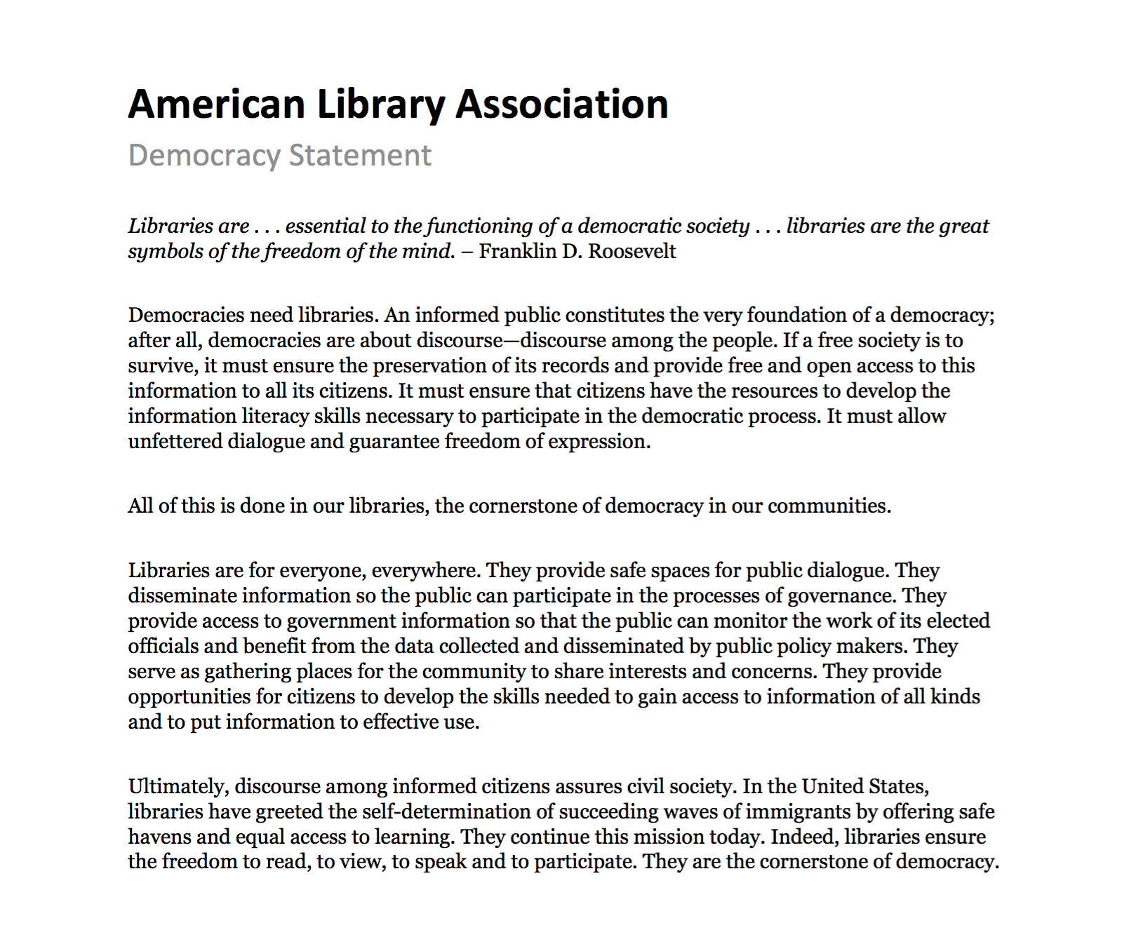
Notes:
Script: American Library Association
[Julie]
I will not read it all as it is quiet lengthy, but I will read this:
Libraries are for everyone, everywhere. They provide safe spaces for public dialogue. They disseminate information so the public can participate in the processes of governance.
I recall texting Hannah going, “this is it–This is the question we are trying to ask!” Archives are just as much of a space for everyone, everywhere like libraries. Can they too provide a safe and brave space for public dialogue? With students, how can they provide a space to challenge discourse and empower students to have conversations they would not otherwise have the opportunity to explore?

Slide 6
PAIN POINT
“If a free society is to survive, it must ensure the preservation of its records and provide free and open access to this information to all its citizens.”
Educational Outreach Program
Accessibility
Notes:
Script: Thesis Question
[Hannah]
How can we address what Julie was talking about within a group of people that already exists within the Archives of Ontario demographic. This is what led us to looking at the educational outreach program. When we heard about the budget cuts towards the travelling workshops and the feedback received from educators who are looking for more materials and support in the classroom, we decided to focus our attention here.
Thus, we are tackling how can archives continue to engage and provide more takeaways for educators and students after attending workshops.

Slide 7

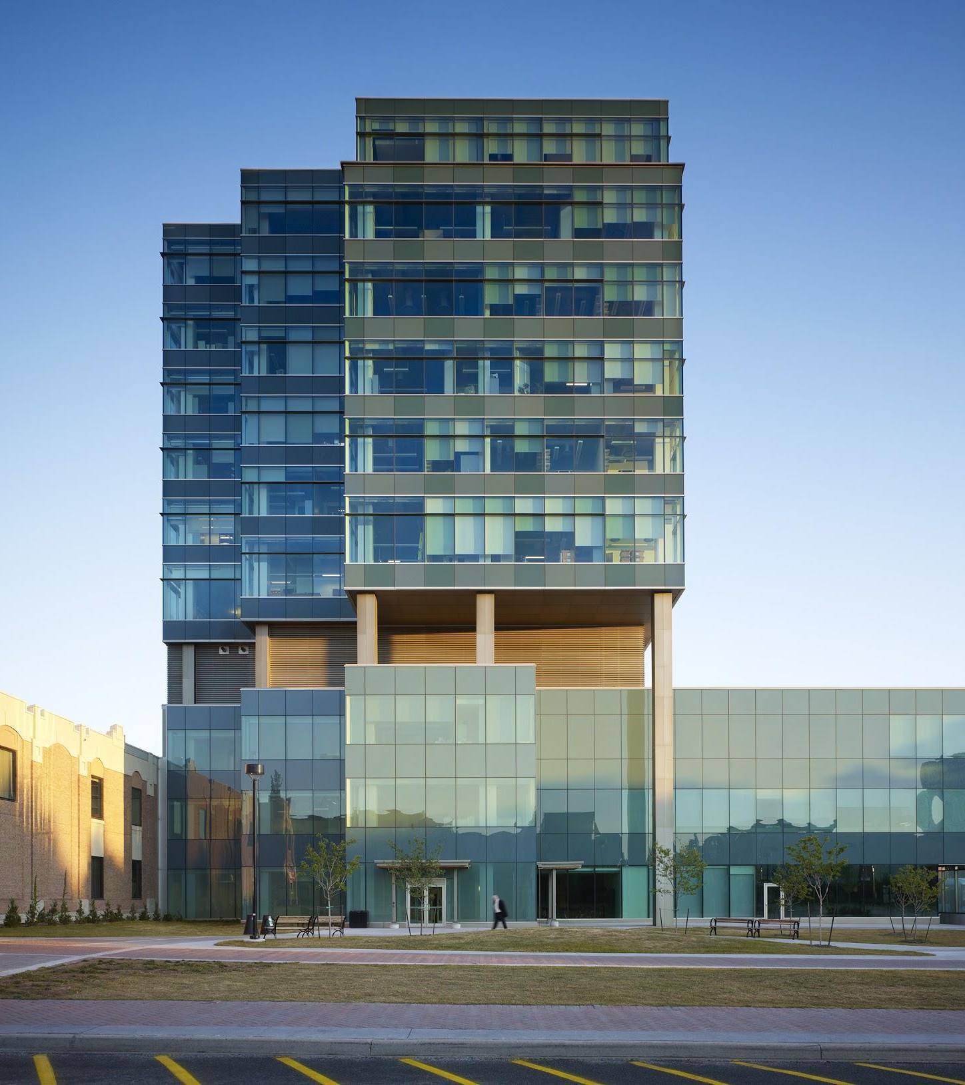
TARGET MARKET
Teachers
Pain points for teachers include accessibility to resources and the lack of materials for topics within and beyond the curriculum.
Students
Pain points for students include accessibility to the facility, knowing what to look for as well as the lack of digital resources.
Notes:
Script: Target Market (Hannah)
[Hannah]
Looking at are target demographic of Teachers and Students we were able to find some commonalities from surveying the two groups that helped confirm the need for our solution.
Apprx. 40% of both teachers and students have heard of AO
Roadblocks including time and accessibility
For teachers - getting to the facility for workshops
For Students - go to the facility, knowing what to look for/how to use the system, lack of digital resources
Therefore the main pain point we wanted to address with our solution is ACCESSIBILITY.
Teachers (30) Students (50)

Slide 8
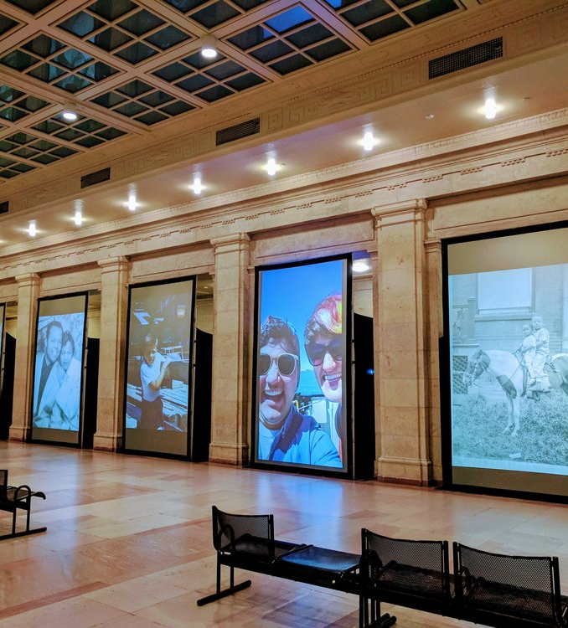
Case Study: Family Camera Network
The Family Camera Network was a collaborative project between a number of institutions but most notable with the Canadian Lesbian and Gay Archives and the Royal Ontario museum to explore the idea of family through building a public archive of family photographs.
Notes:
Script: The Family Camera Network
[Julie]
We will go through a few examples of our inspiration.
Maybe some of you may know the folks from The Family Camera, one of their staff members ended up being a point of contact for me when I was working on the design.
Nonetheless, The Family Camera Network worked on a large projection displaying submissions during Nuit Blanche. It stretched a history of over 100 years. They chose specifically to project this in the west waiting room in Union Station which is a National Historic Site and significant Toronto gateway.
We toddled with the idea of going back to the QR Code but creating some form of installation. It would not be a business model, but instead more so an art piece that would be injected in an area with high foot traffic. Unfortunately, we couldn’t go through with this idea because our class was made for us to create a framework that was similar to a business.

Slide 9
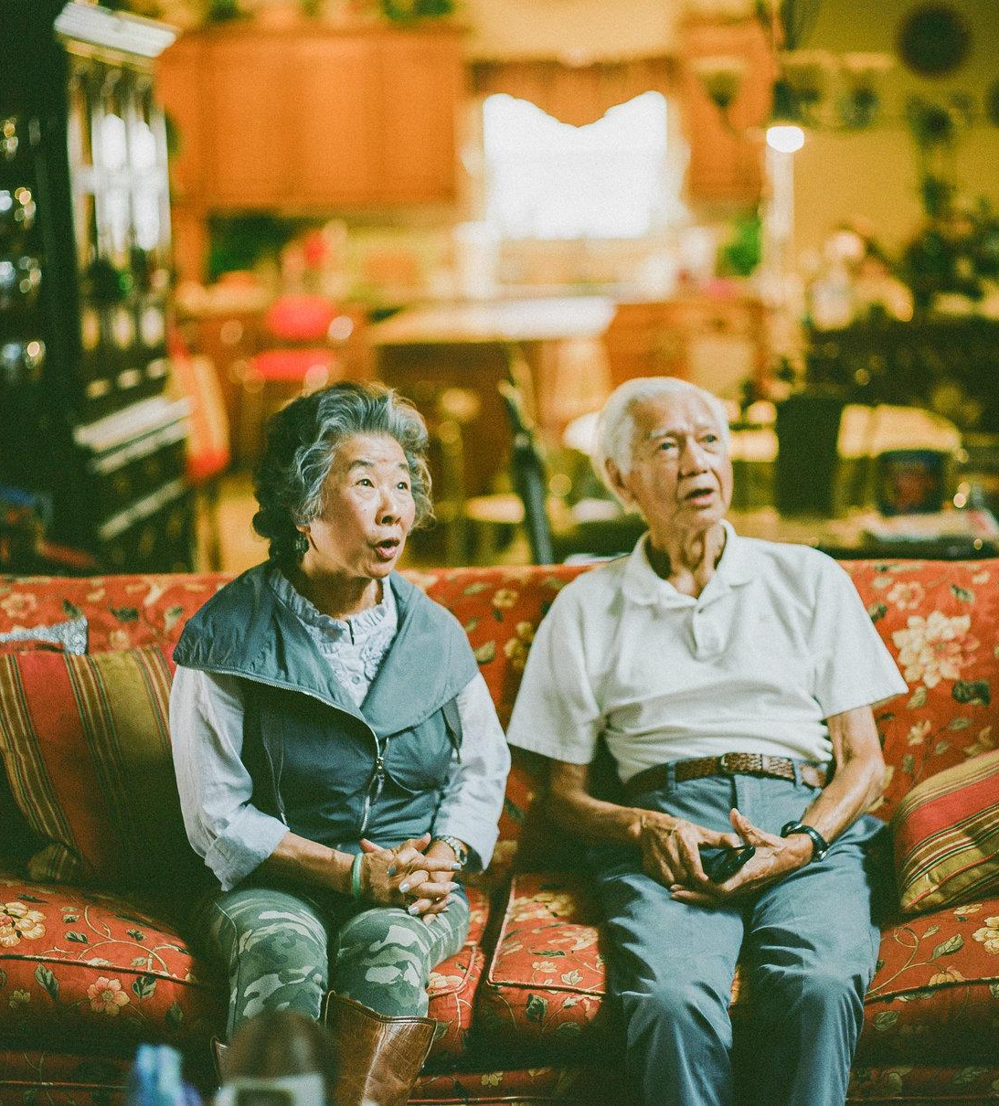
Case Study: Mississippi Delta Chinese
“In our photojournalism project, we interviewed and photographed 16 members of the Chinese American community who grew up in the Mississippi Delta. We interviewed both the young/old and covered topics like cultural identity, racial equality, regional identity, outlook on life, and perspectives on citizenship. All photos were taken on 35mm and medium-format film.”
Notes:
Script: The Mississippi Delta Chinese
[Julie]
This is a case regarding how to document the past and present to give to people to mold the future. I am formally trained as a photographer, so we thought of doing a photojournalism piece or some long form journalism. This would require us to interview and visually document the project.
Once again this was ruled out because of how our class was framed this semester.

Slide 10
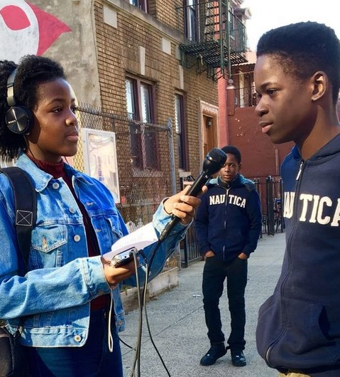
Case Study: Radio Rookies
In 1999, Radio Rookies originally conducted workshops across New York in under-resourced neighbourhoods to train young people to use words and sounds. These workshops led to providing teenagers to create radio stations about themselves, their communities, and the world.
Notes:
Script: Radio Rookies
[Julie]
A project we looked at is Radio Rookies distributed by WNYC. They provide two formal toolkits, one for educators to teach students to do interviews and make their own radio stations. And the other is a DIY toolkit for teens interested in reporting their own stories.
We went through this idea because when we first worked on the QR code, we had two members of our team come up here and digitize artifacts. They would often talk about how fun it was, and how little they knew prior to using the Archives. We thought it would be fascinating to give students the chance to do the same. We would end up documenting students going through the Archives, and making journalistic approaches to it. Whether it be looking for info regarding previous exhibits, or opening the ground to new stories.

Slide 11
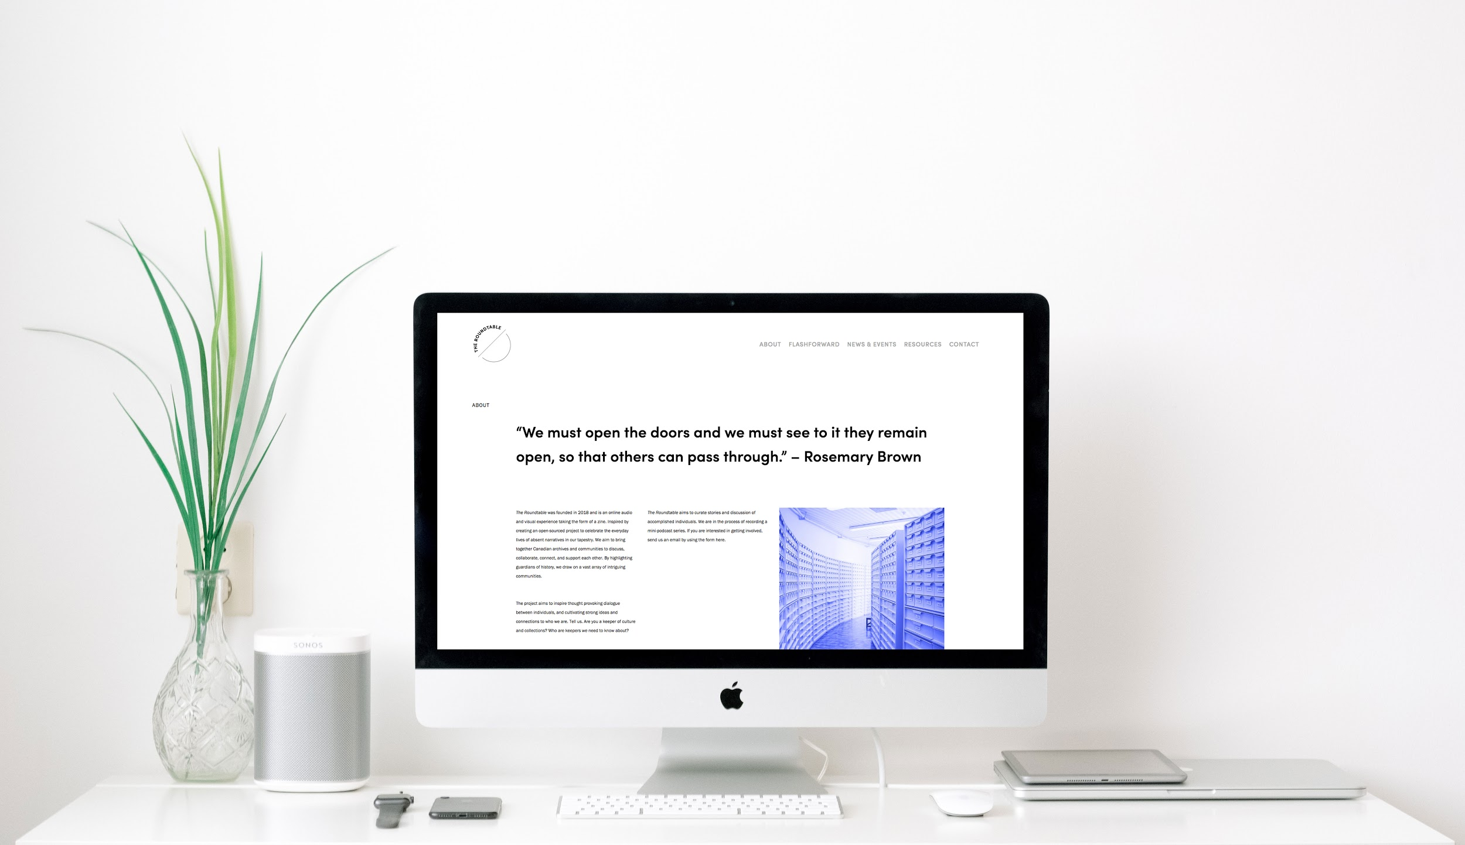
Notes:
Script: The Product (Hannah)
[Hannah]
Educators have requested for programming on Indigenous histories. Archives of Ontario have the materials in their collections, but are unable to consolidate it onto one platform. The Roundtable is an annual online zine that includes items from the Archives of Ontario, the Library and Archives of Canada, and from communal archive projects. It will feature interviews of archivists, and art directors, as well as resources to use in a classroom.
The first issue is called Flashforward–taking past narratives forward in time to recognize a sustained conversation on identity and Ontario’s history in the classroom. P

Slide 12
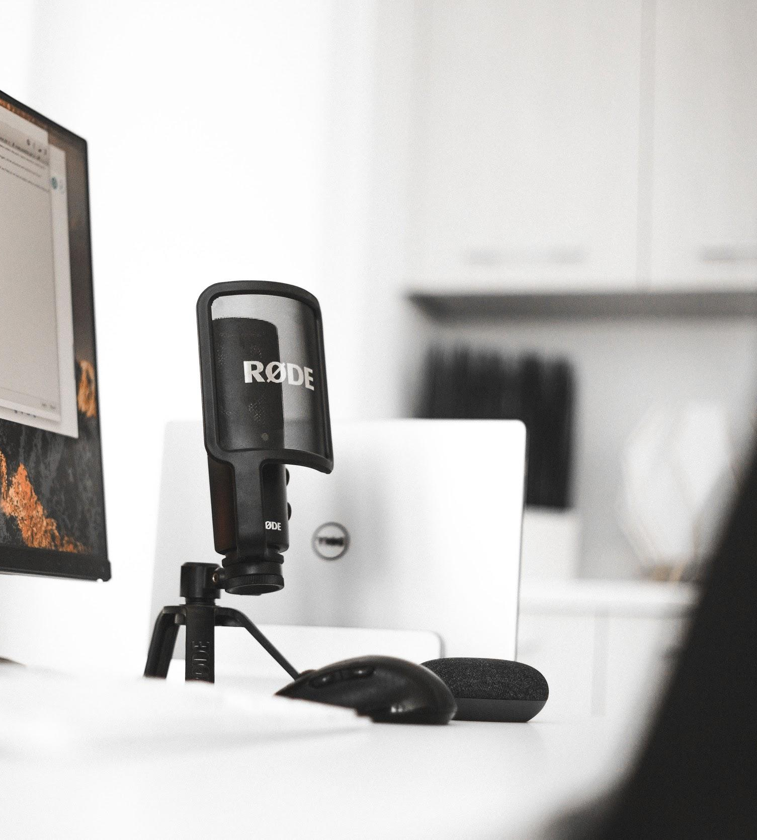
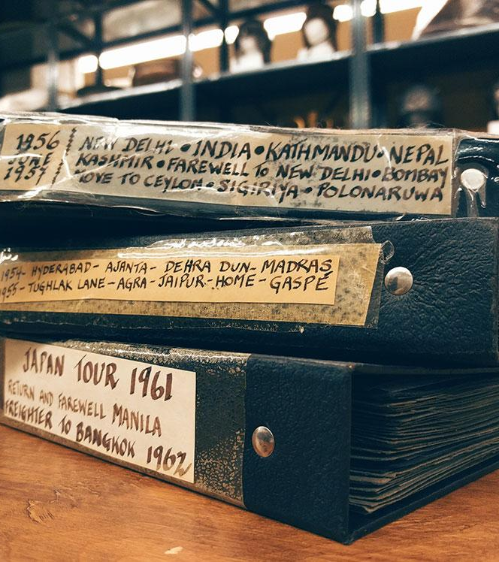
Expansion
Annual Zine
Continuing The Roundtable’s annual zine to cover different topics, possibly adopting an open source model for users to contribute.
Podcast
Adopting a podcasting element to The Roundtable, allowing for a audio component to feature interviews, deep dives into topics, etc.
Events
Using the yearly topic of the Zine as a theme for a annual public event to facilitate conversations and foster a community
Installations
Incorporating physical elements that will draw in people to the facility or allow people to engage with at events
Notes:
Script: Expansion (Hannah)
[Hannah]
From here the Roundtable could be expanded to not only continue the annual zine following different topics but could also expand into a podcast, an event or include installation pieces, all different routes we thought about taking this project in the beginning.

Slide 13

WWW.ROUNDTABLE.SPACE
Notes:
www.roundtable.space

